Slide 1

Node CPU Profiling
PERFORMANCE DEEP DIVE
Create, read and make sense of .cpuprofile files — from one script to a monorepo build.
Notes:
Today: how to record CPU profiles in Node.js, what the file format looks like, and how to deal with many profiles from one run.

Slide 2
Find the code that burns your CPU — then fix the right thing.
WHY PROFILE
01
02
03
Collect
Locate
Optimize
The profiler samples the call stack while your program runs.
The samples show which functions use the most CPU time.
You spend your effort on the hot path, not on guesses.
Node CPU Profiling
02
Notes:
CPU profiling collects data about CPU usage while a program runs. It tells us which parts of the code consume the most CPU, so we can optimize where it matters.

Slide 3
Two ways to start the profiler
CREATE A PROFILE
Command-line flag
NODE_OPTIONS
node --cpu-prof \
-e "console.log('CPU')"
NODE_OPTIONS="--cpu-prof" \
node -e "console.log('CPU')"
Writes a .cpuprofile file to the current working directory when the process exits.
Needs Node.js v23+. Every child process inherits it.
Node CPU Profiling · Official docs: nodejs.org/api/cli.html
03
Notes:
The simplest way is the --cpu-prof flag. Since Node.js 23 the profiling flags are also allowed in NODE_OPTIONS, which matters as soon as your program spawns child processes.

Slide 4


The order of the arguments decides everything
GOTCHA
Bad — no profile
Good — profile in CWD
node script.js --cpu-prof
node --cpu-prof script.js
A flag after the script name goes to your script as an argument. Node never sees it.
Node flags come before the script. The profile lands in the current working directory.
Node CPU Profiling
04
Notes:
The most common mistake: putting --cpu-prof after the script. Then it is just an argument for the script, and no profile is written.

Slide 5
Every filename tells you who wrote it
ANATOMY
CPU.20250510.134625.51430.0.001.cpuprofile
%D Date
%H Time
%P Process ID
%T Thread ID
%N Sequence
Start date, 20250510 = May 10, 2025
134625 = 13:46:25
OS process that wrote the file
0 = main thread, 1+ = workers
Unique per process, not globally
Node CPU Profiling
05
Notes:
The default filename has a fixed prefix CPU, then date, time, process ID, thread ID and a sequence number. The sequence number is only unique inside one process — it is not a global ID.

Slide 6
A new process gets a new PID, a new worker a new TID
PROCESS AND THREAD IDS
PID — process ID
TID — thread ID
OS-level ID, from process.pid
New on fork(), spawn(), exec() or a new node run
The first process has the smallest PID
V8’s internal thread ID
The main thread is always 0
Each new Worker from node:worker_threads gets a new TID
CPU.<ts>.51430.0.001 · parent
CPU.<ts>.51431.0.002 · child 1
CPU.<ts>.51432.0.003 · child 2
CPU.<ts>.51430.0.001 · main
CPU.<ts>.51430.1.002 · worker 1
CPU.<ts>.51430.2.003 · worker 2
Node CPU Profiling
06
Notes:
Check it yourself: node -p "const { threadId } = require('node:worker_threads'); 'PID: ' + process.pid + ', TID: ' + threadId". Spawned processes get new PIDs, worker threads keep the PID and get a new TID.

Slide 7
Four flags control the profiler
CPU PROFILING ARGUMENTS
Flag | Since | Default | What it does
--cpu-prof | v12.0.0 | off | Starts V8’s profiler, writes on exit
--cpu-prof-dir | v12.0.0 | CWD, or --diagnostic-dir | Output directory
--cpu-prof-name | v12.0.0 | CPU + date, time, PID, TID, seq | Custom name, no placeholders
--cpu-prof-interval | v12.2.0 | 1000 µs (1 ms) | Sampling interval in µs
All four started as experimental. Check the Node.js docs for your version.
Node CPU Profiling
07
Notes:
--cpu-prof-dir: if --cpu-prof-name is an absolute path, the dir is ignored; the directory is created if missing. --cpu-prof-name does not support placeholders like pid or timestamp. --cpu-prof-interval defaults to 1000 microseconds.

Slide 8
The interval trades detail for file size
--CPU-PROF-INTERVAL
Interval | Nodes | Samples | Size
1 µs | 472 | 10,514 | 162.0 KB
10 µs | 338 | 931 | 73.3 KB
100 µs | 153 | 100 | 28.9 KB
1000 µs · default | 49 | 10 | 8.6 KB
5000 µs | 15 | 3 | 2.7 KB
10000 µs | 3 | 2 | 0.5 KB
Small interval
More samples and detail. Bigger files, a bit more overhead. Good for short runs.
Large interval
Fewer samples, small files, less overhead. Good for long runs.
Same script (console.log only), profiled with different intervals
08
Notes:
We profiled an empty console.log script with intervals from 1 to 10,000 microseconds. Start with the default of 1000 microseconds and adjust to the detail you need and the file size you can accept.

Slide 9
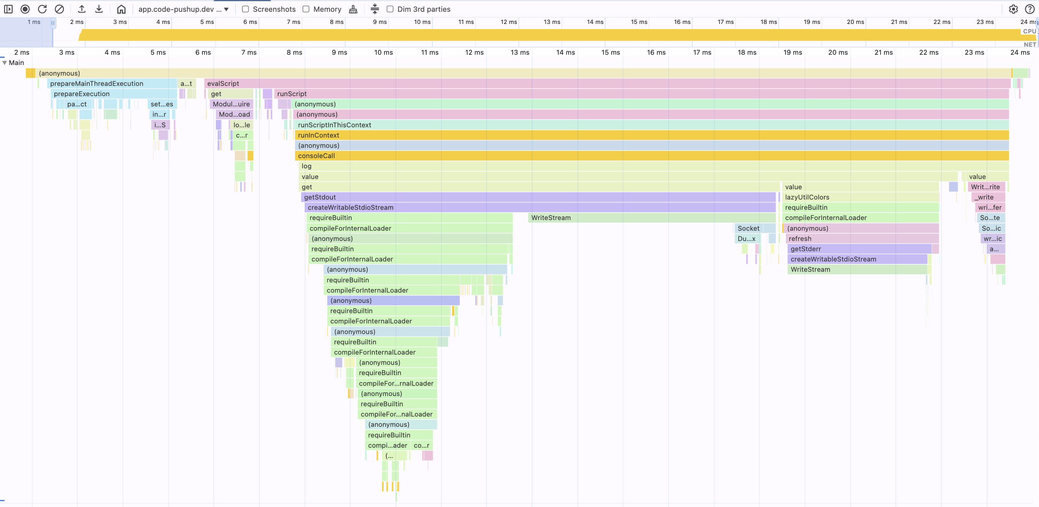
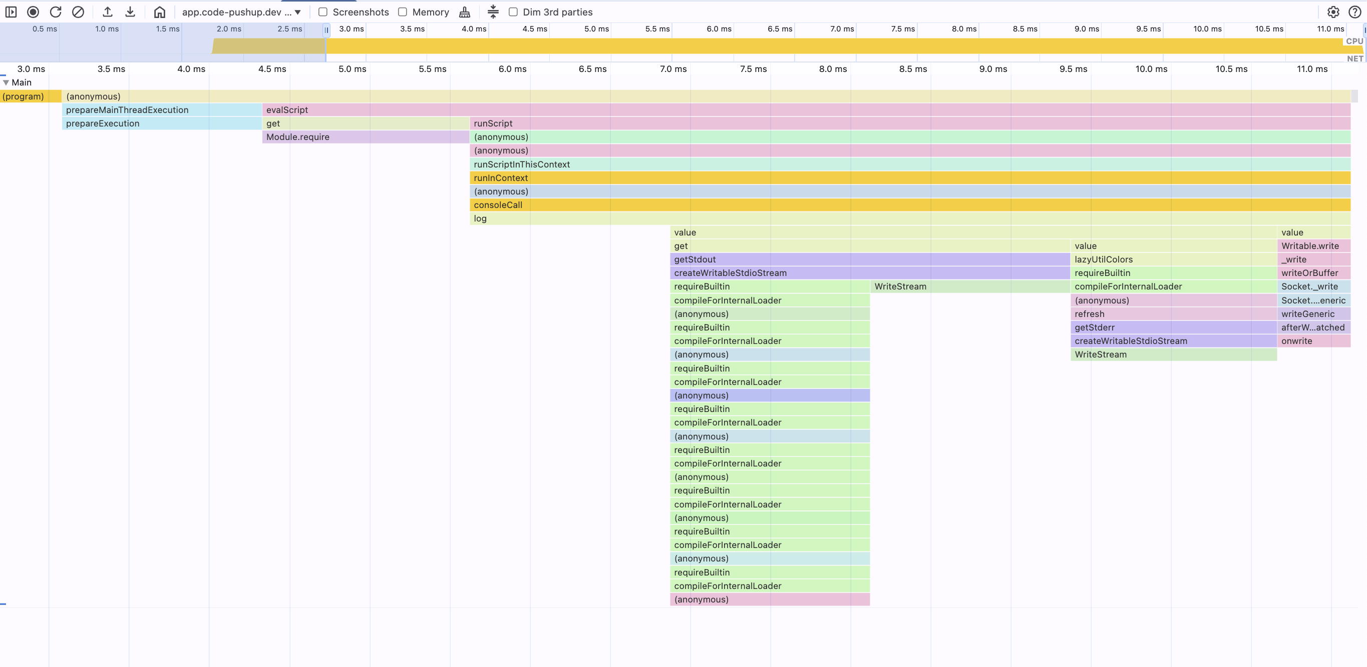
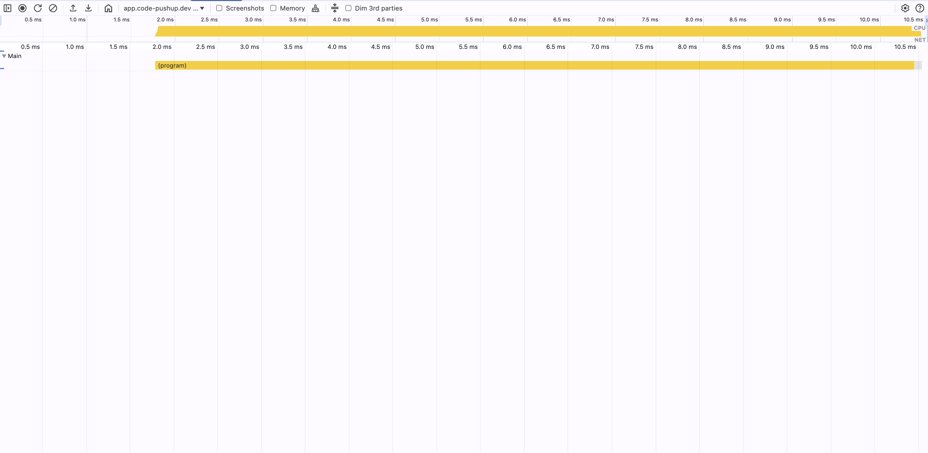
Same script, three intervals, three pictures
--CPU-PROF-INTERVAL
1 µs
1000 µs · default
10000 µs
10,514 samples · 162 KB
10 samples · 8.6 KB
2 samples · 0.5 KB
Below the default you see the real call tree. Far above it, most frames disappear.
Node CPU Profiling · DevTools Performance panel
09
Notes:
The same empty script in DevTools. At 1 microsecond we see 472 nodes; at 10,000 microseconds only 3 nodes survive.

Slide 10
Pin the output folder with an absolute path
TROUBLESHOOTING
Before: one file per process CWD
After: all files in one folder
/root
├── CPU…42154.0.001.cpuprofile
└── packages
├── pak1/CPU…0.003.cpuprofile
├── pak2/src/lib/CPU…0.002.cpuprofile
└── pak3/CPU…0.004.cpuprofile
/root
└── profiles
├── CPU…42154.0.001.cpuprofile
├── CPU…42154.0.002.cpuprofile
├── CPU…42154.0.003.cpuprofile
└── CPU…42154.0.004.cpuprofile
node --cpu-prof --cpu-prof-dir=/Users/username/reponame/profiles script.js
Node CPU Profiling · on Windows use C:\Users\username\reponame\profiles
10
Notes:
Node writes each profile relative to the CWD of the process that wrote it. In a monorepo every package runs in its own folder, so the files end up all over the place. An absolute --cpu-prof-dir collects them in one folder.

Slide 11
“--cpu-prof is not allowed in NODE_OPTIONS”
TROUBLESHOOTING
≤ v22
≥ v23
Blocked
Allowed
All CPU profiling flags are blocked in NODE_OPTIONS for security reasons.
All CPU profiling flags work in NODE_OPTIONS (nodejs/node PR #57018).
Workaround v22 and older
node --require ./cpu-prof.js script.js
Node CPU Profiling
11
Notes:
Test your version: NODE_OPTIONS="--cpu-prof" node -e "console.log('test')" 2>/dev/null and check if it succeeds. On v22 and older, a small patch script loaded with --require starts the profiler programmatically for every thread.

Slide 12
Combine the flags for your use case
RECIPES
A/B comparison
Benchmark in detail
node --cpu-prof \
--cpu-prof-name=version-a.cpuprofile \
version-a.js
node --cpu-prof --cpu-prof-interval=20 \
--cpu-prof-dir=./microbench \
util.js
Named files you can find again.
Frequent samples to find a bottleneck.
CI/CD pipeline (v23+)
Options in a .env file
NODE_OPTIONS="--cpu-prof \
--cpu-prof-interval=5000 \
--cpu-prof-dir=/abs/profiles" node main.js
# .env
NODE_OPTIONS="--cpu-prof --cpu-prof-dir=/abs"
node --env-file .env main.js
Long runs, every process and worker, one folder.
Keep the setup out of your scripts.
Node CPU Profiling
12
Notes:
Four common combinations. For A/B tests, give each run a name. For micro benchmarks, sample often. In CI, use NODE_OPTIONS with a large interval and an absolute directory so child processes and workers land in the same folder.

Slide 13
A .cpuprofile is plain JSON
DATA STRUCTURE
type CpuProfile = {
nodes: Node[];
startTime: number; // µs
endTime: number; // µs
samples: number[]; // node ids
timeDeltas: number[]; // µs
};
A call tree of nodes, plus a timeline: which node was on top of the stack at each sample, and how far apart the samples are.
Node CPU Profiling
13
Notes:
Five fields. nodes is the call tree. startTime and endTime are microsecond timestamps. samples lists node IDs, one per tick. timeDeltas lists the microseconds between ticks.

Slide 14
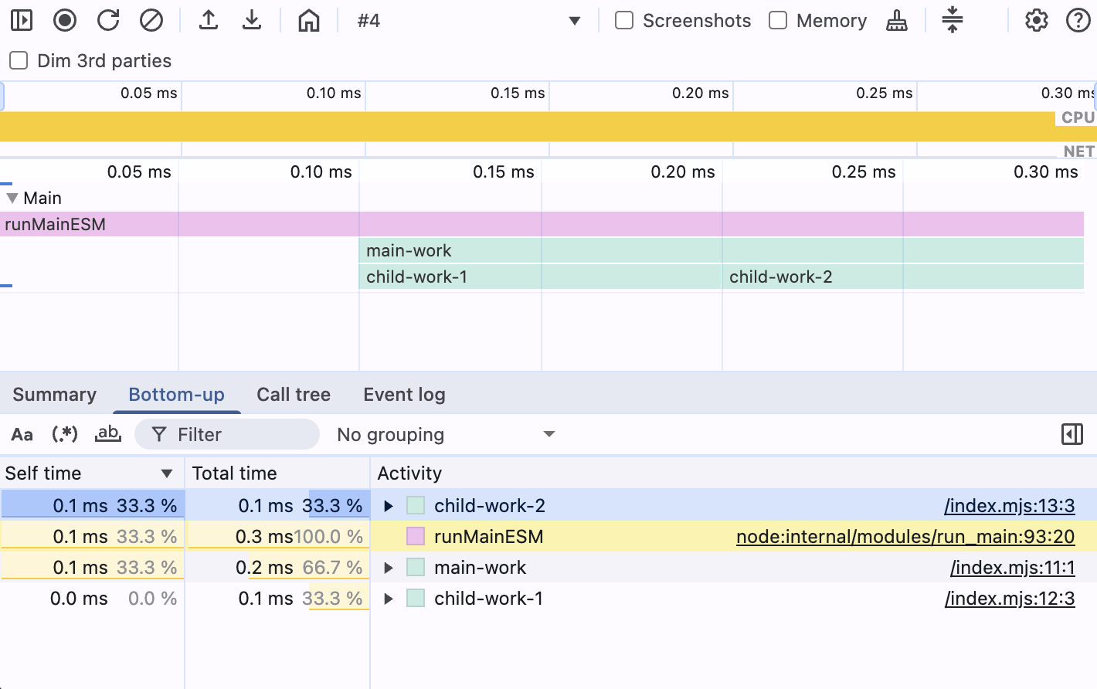
Five nodes and three samples make a flame chart
MINIMAL PROFILE
nodes → the call tree
1 (root)
└─ 2 runMainESM
└─ 3 main-work
├─ 4 child-work-1
└─ 5 child-work-2
samples + timeDeltas → the timeline
samples: [2, 4, 5]
timeDeltas: [0, 100, 100]
startTime: 1, endTime: 400
examples/minimal-cpu-profile.cpuprofile
14
Notes:
This is the smallest useful profile. Five nodes form the tree, three samples place them on the timeline. Load the file in the DevTools Performance panel to see exactly this chart.

Slide 15
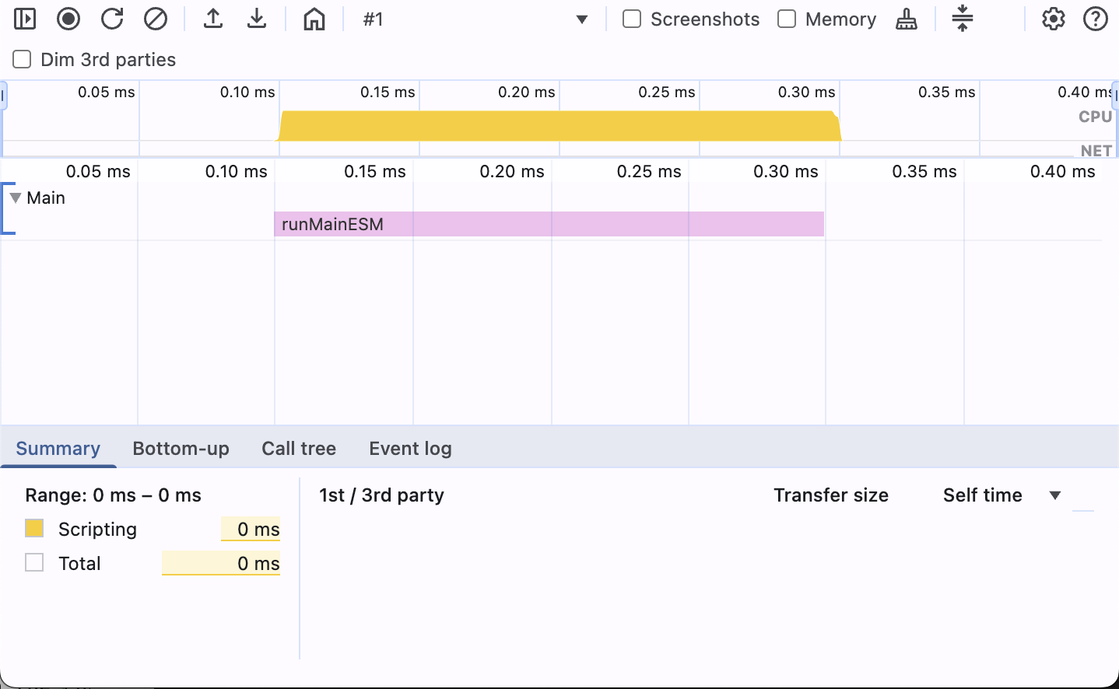
Two axes: time across, call depth down
DIMENSIONS AND TIMING
Time → horizontal
startTime: when profiling began (µs)
endTime = startTime + Σ timeDeltas
timeDeltas: µs between sample ticks
Depth → vertical
(root) sits at depth 0
samples hold the leaf frames
Parents are rebuilt for the chart
samples [1, 2, 2, 1] · timeDeltas [0, 100, 100, 100] — one node, centered in the chart
15
Notes:
Time runs from startTime to endTime. Depth starts at the root node. In this example the root samples before and after node 2 center it in the chart.

Slide 16
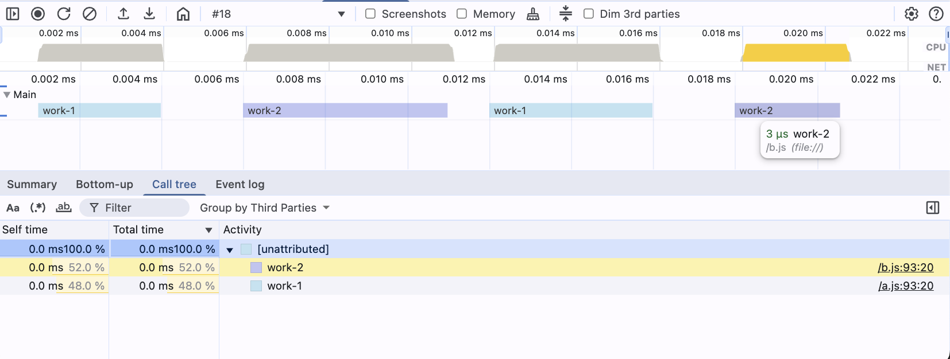
Uneven deltas make uneven frame widths
TIME DELTAS
Each entry in timeDeltas is the time in µs since the previous sample tick.
samples
[1, 2, 1, 3, 1, 2, 1, 3]
timeDeltas
[0, 1, 3, 2, 5, 1, 4, 2]
examples/minimal-cpu-profile-timing-data-time-deltas.cpuprofile
16
Notes:
work-1 and work-2 alternate with the root. Because the deltas differ, the frames in the chart get different widths.

Slide 17
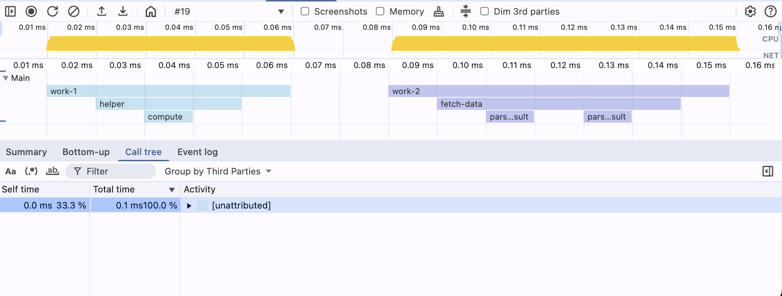
A sample names the leaf frame — the stack comes with it
SAMPLES
List the deepest node at a tick. DevTools draws all its parents too.
samples
[1, 2, 4, 5, 4, 2, 1,
1, 3, 6, 7, 6, 7, 6, 3, 1]
timeDeltas
[0, 10, 10, …, 10]
examples/minimal-cpu-profile-timing-data-samples.cpuprofile
17
Notes:
Samples are the visible nodes seen from the bottom of the chart. Naming node 5 at a tick also draws 4, 2 and the root above it. Stepping down and up the tree gives the flame shape.

Slide 18
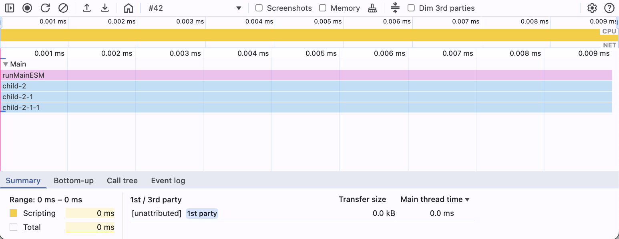
parent and children link the call tree
NODES
type Node = {
id: number;
callFrame: CallFrame;
parent?: number;
children: number[];
hitCount?: number;
};
samples: [6] — DevTools walks up from node 6. Nodes off that path, like child-1, are not drawn.
examples/minimal-cpu-profile-nodes-parent-child.cpuprofile
18
Notes:
parent is the ID of the caller and is left out on the root. children lists the callees. Start at the root and recurse through children to rebuild the full tree, for example to sum inclusive and exclusive hit counts.

Slide 19
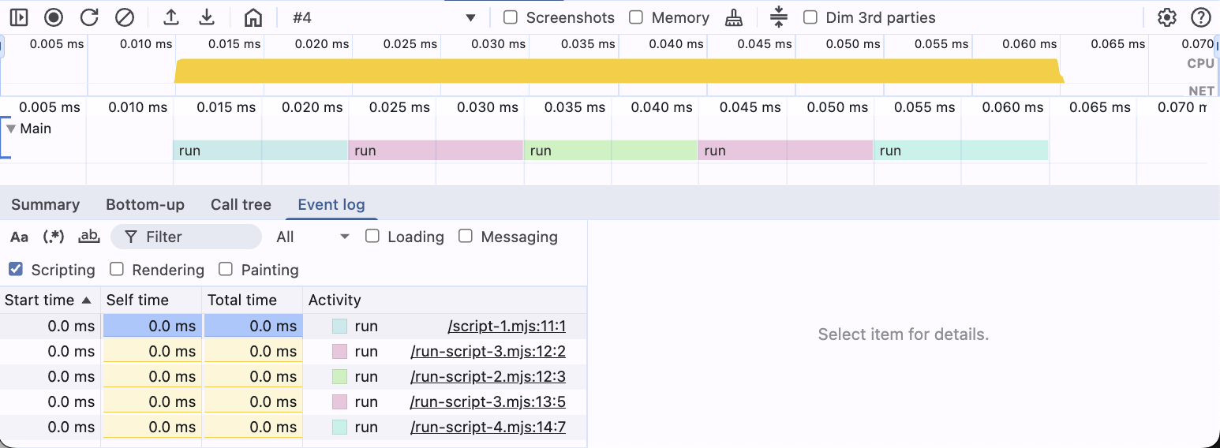
The callFrame labels each frame — its url sets the color
CALLFRAME
type CallFrame = {
functionName: string;
scriptId: string;
url: string;
lineNumber: number;
columnNumber: number;
};
Five frames, all named run. Frames from the same url share one color.
examples/minimal-cpu-profile-nodes-call-frame-url.cpuprofile
19
Notes:
functionName, url, line and column are what DevTools shows on hover. The url also drives the color: run-script-3.mjs appears twice and gets the same color both times.

Slide 20
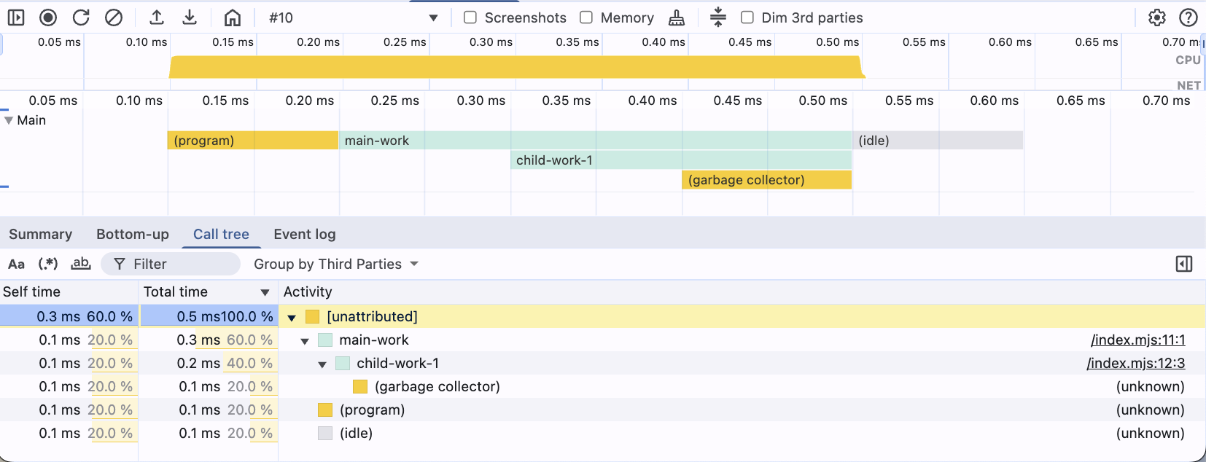
Names in parentheses come from V8, not from your code
SYNTHETIC FRAMES
Frame | Meaning
(root) | Start of the profile session
(program) | Top-level script code
(idle) | Nothing runs, the app waits
(garbage collector) | V8 reclaims memory
Always scriptId "0", url "" and line and column −1.
examples/minimal-cpu-profile-nodes-call-frame-synthetic-frames.cpuprofile
20
Notes:
Synthetic frames are markers V8 adds. They separate your own code from runtime overhead such as idle time and garbage collection.

Slide 21
profiles from one Angular build — one per worker thread
REAL LIFE · WORKER THREADS
32
node --cpu-prof \
--cpu-prof-dir=./angular-build \
node_modules/.bin/ng build
Good luck reading that by hand.
Node CPU Profiling
21
Notes:
The Angular build spreads its work over worker threads. Each thread writes its own profile, so one build gives us 32 files — CPU.ts.pid.0.001 up to CPU.ts.pid.32.032.

Slide 22


Child processes need NODE_OPTIONS and an absolute dir
REAL LIFE · CHILD PROCESSES
Works — every process writes to one folder
NODE_OPTIONS="--cpu-prof --cpu-prof-dir=/Users/user/workspace/cpu-prof-processes" node ./spawn.js
Fails — the flags stay with the parent
node --cpu-prof --cpu-prof-dir=./cpu-prof-processes ./spawn.js
Fails — relative dir resolves against each child’s CWD
NODE_OPTIONS="--cpu-prof --cpu-prof-dir=./cpu-prof-processes" node ./spawn.js
examples/exmpl-spawn-processes.js
22
Notes:
A real example is an Nx monorepo: NODE_OPTIONS="--cpu-prof --cpu-prof-dir=/abs/path" nx run-many -t build --skip-nx-cache. You get one profile per spawned process plus one per worker thread. In practice, use the Nx TUI timings first and only profile the slow part in detail.

Slide 23
How to make sense of many profiles
BEST PRACTICES
01
Less is more
Open a few profiles from one run, then plan focused measures.
02
Rename your profiles
Give files meaningful names you can come back to.
03
Isolate your measures
Found the culprit? Run only that part with -e or a micro benchmark.
04
Go for quick wins
Fix what you understand, with high impact and low effort. Write it down.
05
Use the right tools
Merge many profiles into one view with @push-based/cpu-prof.
Node CPU Profiling
23
Notes:
There is no official tool to view many profiles from one measurement. So: keep the number small, rename files, isolate the slow part, focus on quick wins, and use tooling that merges profiles.

Slide 24
@push-based/cpu-prof
NEXT STEP
A CLI that creates and merges many CPU profiles into one file the Chrome DevTools Performance panel understands.
Thank you.
Notes:
Wrap up: record with the right flags, understand the JSON, and merge many profiles into one view with @push-based/cpu-prof.

